Slide 1

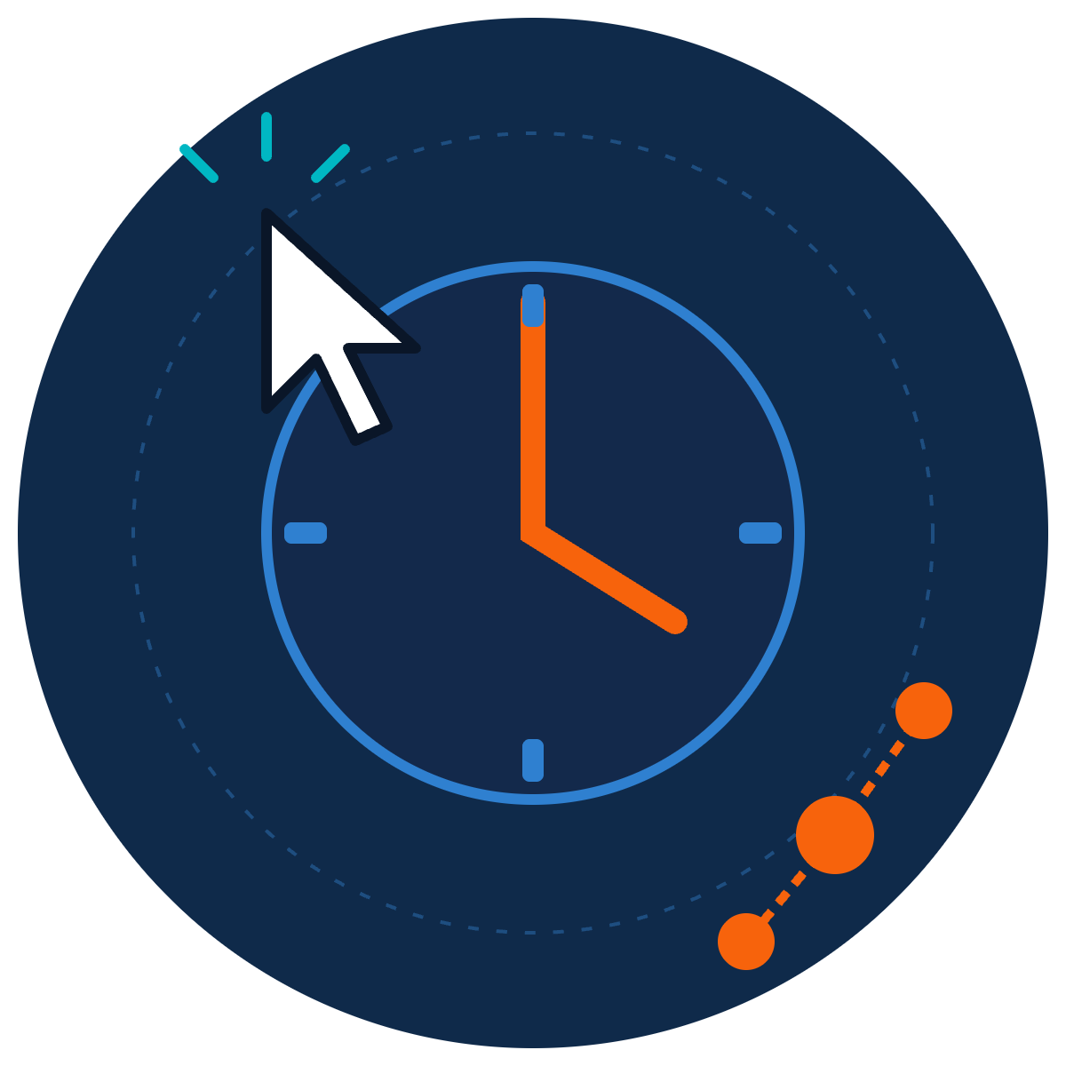
What Happens After You Click?
ZNEXORA TECH | SECURITY AWARENESS
One click to a full breach, minute by minute
Presented by: ZNexora Tech · [Presenter] · [Date]
Notes:
[0:00 – 0:35] Good [morning/afternoon], everyone. I'm [Presenter] from ZNexora Tech. We often hear 'don't click suspicious links', but rarely what actually happens if you do. So today, we're going to follow one click, minute by minute, from a normal Monday morning to a full company breach. Then we'll rewind and see how the same story ends very differently.

Slide 2


Monday, 9:00 AM. An ordinary inbox.
01 · THE SETUP
Inbox · 47 unread
From: HR Payroll <payroll@hr-portal-update.com>
Action required: confirm your bonus details today
Meet Alex
Hi Alex, your Q3 bonus is ready. Please review the attached summary and verify your details by 12:00 to avoid delays.
Works in finance. Busy Monday. Coffee in one hand, 47 emails waiting.
View bonus summary
The email looks normal. Alex clicks.
Illustrative scenario based on real attack patterns · Alex is fictional
ZNexora Tech · 2
Notes:
[0:35 – 1:25] Meet Alex. Alex works in finance, it's 9 o'clock on a busy Monday, and there are 47 unread emails waiting. One of them looks like it's from HR payroll: 'Action required: confirm your bonus details today.' It's personal, it's about money, and it has a deadline: three classic triggers. If you look closely, the sender's domain isn't our real HR domain. But Alex is busy, the email looks normal, and Alex clicks. Alex is fictional, but this story follows a real and very common attack pattern. Let's see what happens next.

Slide 3


From one click to a full breach
02 · THE TIMELINE
0:00
0:01
0:02
0:10
0:29
Day 1–3
Day 5
Click
Run
Steal
Log in
Spread
Exfiltrate
Encrypt
Minutes 0–29: on Alex's laptop
Day 1 onward: across the whole company
Illustrative scenario based on real attack patterns
ZNexora Tech · 3
Notes:
[1:25 – 2:10] Here's the full timeline we'll follow. Minute zero: the click. Minute one: something runs. Minute two: data is stolen. Minute ten: the attacker logs in as Alex. Minute twenty-nine: the attacker spreads to other systems. Days one to three: company data is quietly copied out. And day five: ransomware locks everything. Notice the shape: for the first half hour, the problem is on one laptop. After that, it's a company-wide incident. Keep that 29-minute mark in mind.

Slide 4



The click and the trap
03 · MINUTE 0 TO 1
0:00
The click
Verify you are human
FAKE
Alex opens a page that looks like a payroll portal.
To view your bonus summary:
0:01
1
Press Windows + R
The trick
2
A fake check asks Alex to paste and run a command.
Press Ctrl + V
3
Press Enter
0:01
The install
Hidden malware installs silently. Nothing looks wrong.
Illustrative scenario based on real attack patterns · ClickFix technique
ZNexora Tech · 4
Notes:
[2:10 – 3:10] Minute zero. Alex clicks 'View bonus summary' and lands on a page that looks like a payroll portal. Instead of the document, a box appears: 'Verify you are human.' It says press Windows and R, then Control and V, then Enter. This is the ClickFix trick. The page has already copied a malicious command to Alex's clipboard. By minute one, Alex has pasted and run it. Hidden malware installs silently in the background. The page might even show the real bonus document afterwards. From Alex's point of view, nothing looks wrong at all. And that's the key lesson of this slide: a successful attack usually looks like nothing happened.

Slide 5







Silent theft, then a quiet login
04 · MINUTE 2 TO 10
0:02 · STOLEN AND SENT IN SECONDS
0:10 · THE ATTACKER BECOMES ALEX
Saved passwords
Session cookies
Logs in as Alex using the stolen session cookie: no password or MFA prompt needed
Payment details
Recent documents
Reads finance emails and learns who approves payments
Everything is packaged and uploaded to the attacker before Alex finishes their coffee.
Creates a hidden rule forwarding invoices to the attacker
Illustrative scenario based on real attack patterns · Infostealer and session hijacking
ZNexora Tech · 5
Notes:
[3:10 – 4:10] Minute two. The malware is an infostealer. In seconds, it collects Alex's saved browser passwords, session cookies, payment details and recent documents, packages them, and uploads them to the attacker, all before Alex finishes their coffee. Minute ten. The attacker uses the stolen session cookie to log in as Alex. Because a session cookie proves you've already logged in, there's no password prompt and no MFA challenge. The attacker reads finance emails to learn who approves payments, then quietly creates a hidden rule that forwards invoices to themselves. To the company's systems, this looks exactly like Alex working normally.

Slide 6
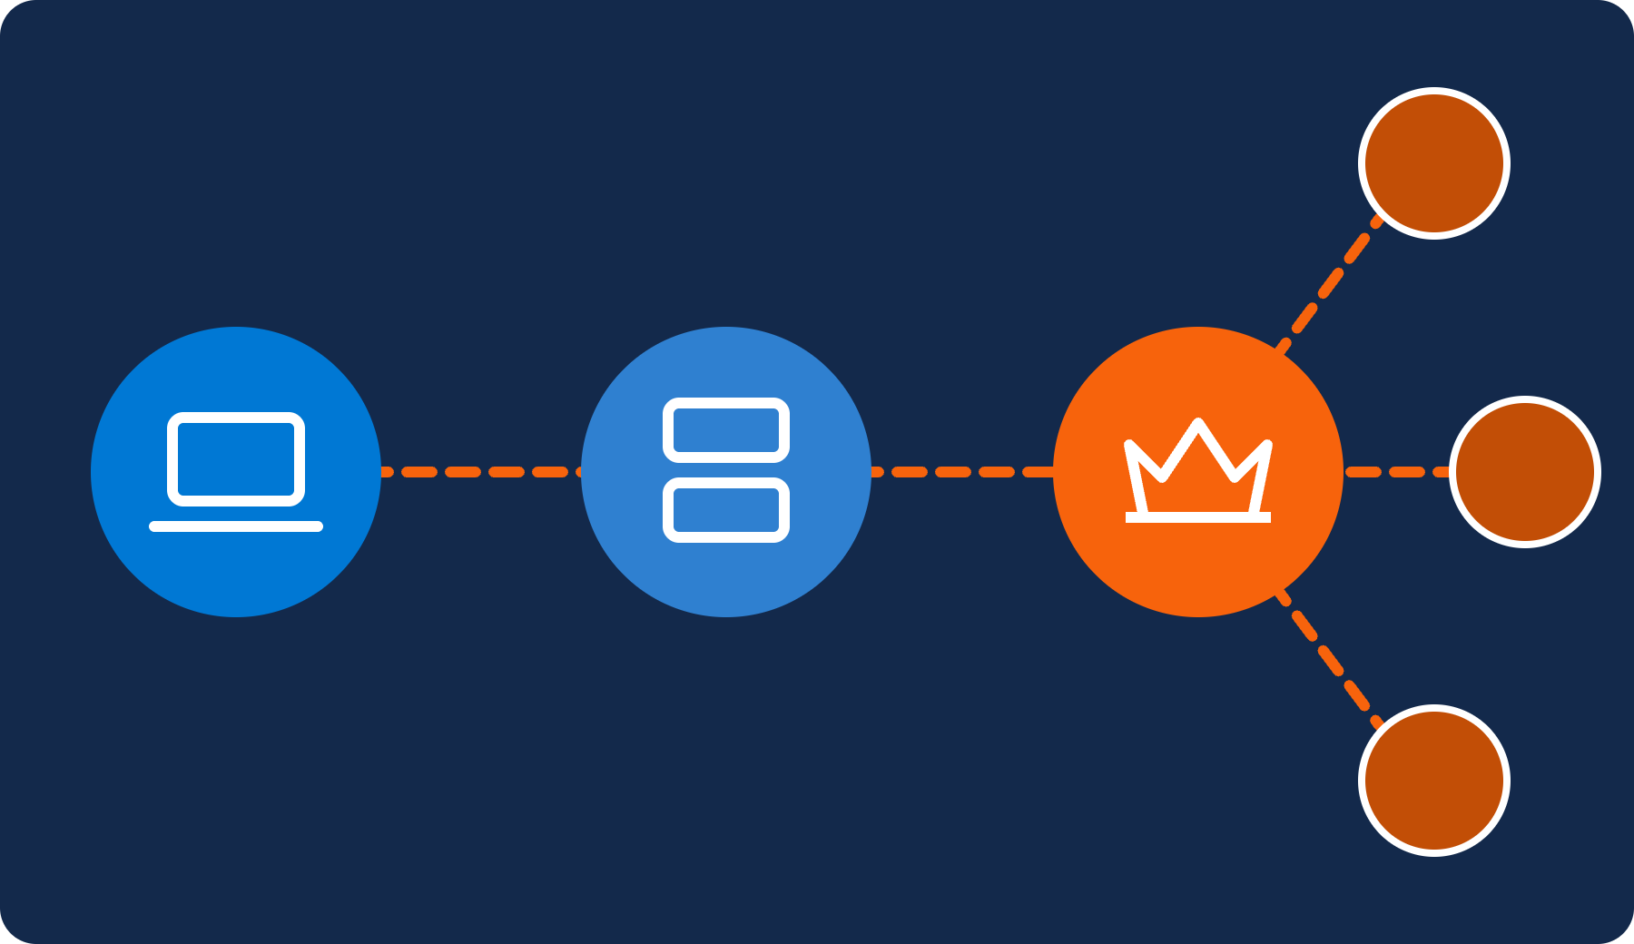
Breakout: from one laptop to the network
05 · MINUTE 29
29 min
average time for attackers to break out to other systems
27 sec
fastest breakout observed
Alex's laptop
File server
Admin account
Every other system
Source: CrowdStrike 2026 Global Threat Report
ZNexora Tech · 6
Notes:
[4:10 – 5:00] Minute twenty-nine. This is the breakout: the moment the attacker moves from Alex's laptop to other systems. Using Alex's access, they reach a shared file server. There they find a script containing an administrator's password, and with admin rights, they can reach almost every system in the company. Is 29 minutes realistic? CrowdStrike's 2026 Global Threat Report found that the average breakout time is exactly that, 29 minutes, and the fastest they observed was just 27 seconds. So if something is going to be stopped cheaply, it has to be stopped in that first half hour.

Slide 7





Steal, sabotage, then encrypt
06 · DAY 1 TO 5
DAY 1–3
Steal the data
Customer records and financial files copied out slowly, to avoid alarms.
YOUR FILES ARE ENCRYPTED
DAY 4
Sabotage recovery
Backups found and deleted so the company can't simply restore.
We also copied your data. Pay within 72 hours or it will be published.
DAY 5
71:59:42
Encrypt everything
Ransomware runs on every system at once, often overnight or at a weekend.
Illustrative scenario based on real attack patterns · Double-extortion ransomware
ZNexora Tech · 7
Notes:
[5:00 – 5:50] Over the next few days, the attacker works quietly. Days one to three: they copy customer records and financial files out of the company, slowly, to avoid setting off alarms. Day four: they find the backups and delete them, so the company can't simply restore. Day five: ransomware runs on every system at once, often overnight or at a weekend when fewer people are watching. On Monday morning, every screen shows a message like this one: your files are encrypted, we've copied your data, pay within 72 hours or it will be published. This is called double extortion, and it all started with one click, one week earlier.

Slide 8
What that one click can cost
07 · THE REAL COST
$4.99M
247 days
48%
global average cost of a breach, a record high
average time to identify and contain a breach
of breaches now involve ransomware
IBM 2026
IBM 2026
Verizon DBIR 2026
Plus downtime, lost customers, legal costs and reputational damage.
Sources: IBM Cost of a Data Breach Report 2026 · Verizon DBIR 2026
ZNexora Tech · 8
Notes:
[5:50 – 6:30] What does that click cost? IBM's 2026 report puts the global average cost of a breach at 4.99 million dollars, a record high. On average it takes 247 days to identify and contain a breach, which is eight months of disruption. And Verizon found that ransomware is now involved in 48 percent of breaches. On top of that come downtime, lost customers, legal costs and reputational damage. That's the price of a click nobody reported.

Slide 9



The alternate ending
08 · REWIND
Alex stays silent
Alex reports in minute 2
0:00
Alex clicks and runs the command
0:00
Alex clicks and runs the command
0:02
Data stolen; Alex says nothing
0:02
Alex thinks: that was strange. Calls IT.
0:29
Attacker spreads to the network
0:10
IT isolates the laptop, revokes sessions
Day 5
Ransomware; company stops
0:30
Contained. One laptop rebuilt. Done.
Same click. Thirty minutes of cleanup instead of months of recovery.
Illustrative scenario based on real attack patterns
ZNexora Tech · 9
Notes:
[6:30 – 7:30] Now let's rewind and replay the same story with one change. On the left, Alex stays silent: the click, the theft, the spread, and on day five the company stops. On the right, Alex makes exactly the same mistake and clicks and runs the command. But at minute two, Alex thinks, 'That was strange, a real website would never ask me to do that,' and calls IT. By minute ten, IT has isolated the laptop and revoked Alex's sessions, so the stolen cookies are useless. By minute thirty, it's contained: one laptop rebuilt, passwords reset, done. Same click. Thirty minutes of cleanup instead of months of recovery. The difference wasn't the click. It was the report.

Slide 10




Five moments you can stop the attack
09 · YOUR CHECKPOINTS
1
2
3
4
5
Before you click
Before you run
Protect your logins
Report in minutes
Keep it updated
Check the sender, the link and the pressure.
Never paste commands a website gives you.
Updates and EDR slow attackers down.
MFA, a password manager, no browser-saved passwords.
Something strange? Call IT on [contact] now.
Clicked something already? Report it. You will never be blamed for reporting.
ZNexora Tech security guidance
ZNexora Tech · 10
Notes:
[7:30 – 8:30] So where could this attack have been stopped? There are five moments. One, before you click: check the sender, the link, and any pressure to act fast. Two, before you run anything: never paste commands a website gives you. Three, protect your logins: use MFA and a password manager, and don't save passwords in your browser. Four, the most important one: report in minutes. If something seems strange, call IT on [contact] straight away. And five, keep your devices updated, because updates and EDR slow attackers down and buy us time. And if you've already clicked something, please report it. You will never be blamed for reporting.

Slide 11
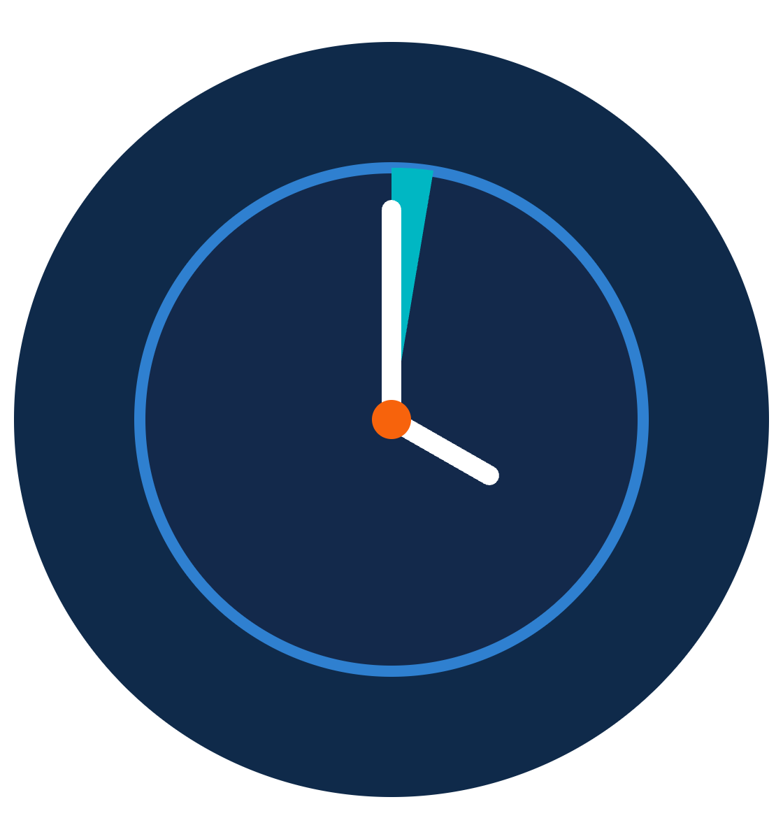
The first minute matters most.
QUESTIONS AND DISCUSSION
Pause before you click. Report the moment it feels wrong.
Thank you · Presented by ZNexora Tech
Notes:
[8:30 – 9:00] To wrap up: one click took Alex's company from an ordinary Monday to a full breach in five days. But the same click, reported in two minutes, became a thirty-minute fix. The first minute matters most. Pause before you click, and report the moment something feels wrong. Thank you. I'm happy to take any questions.

